Slide 1

Group - 3
Domain : Health Care
Proposed project: Prediction on Hospital Readmission
Team members: Vipul Inaparty
Nihar Penchala
Naveen Kumar Chukka
Mentor Name: Mr. Animesh Tiwari

Slide 2
Problem Statement:
To obtain a measurement of patients with diabetes to predict readmission rates which may prove valuable in the development of strategies to reduce readmission rates and costs for the care of hospital.
We need to predict patient readmission rate for less than 30 days.

Slide 3
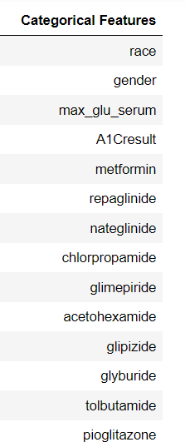
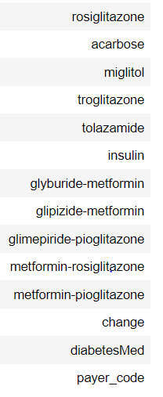
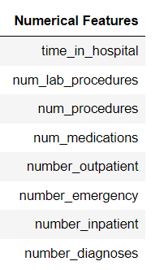
Data Overview:
Numerical features: Categorical features:

Slide 4
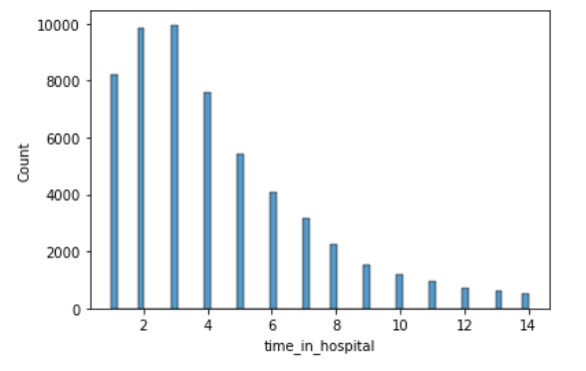
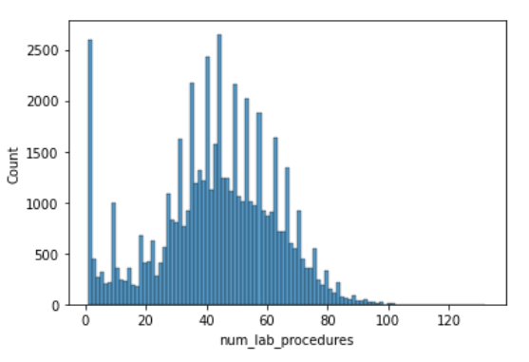
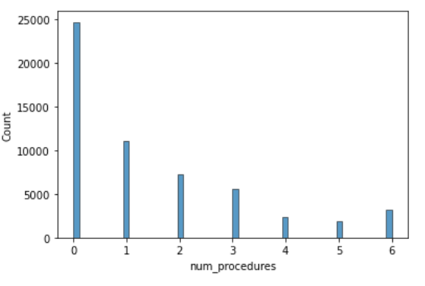
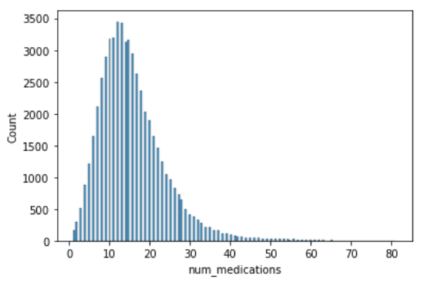
Exploratory Data Analysis:

Slide 5
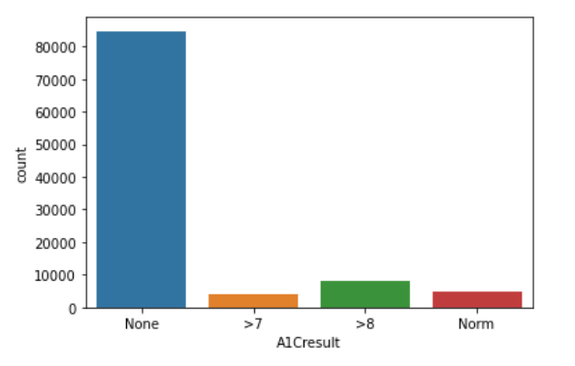
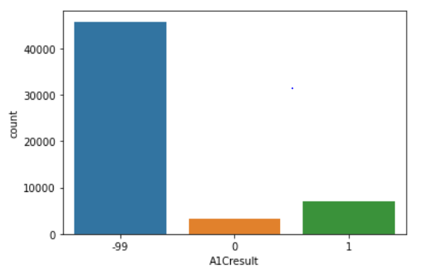
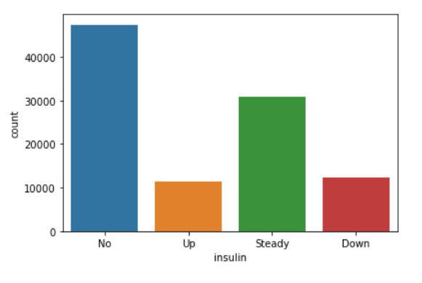
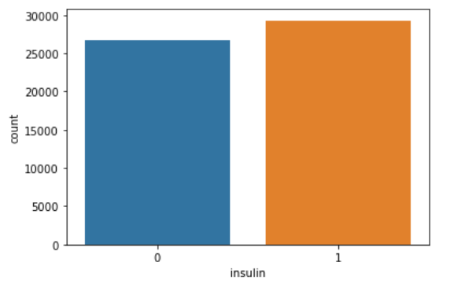


Slide 6
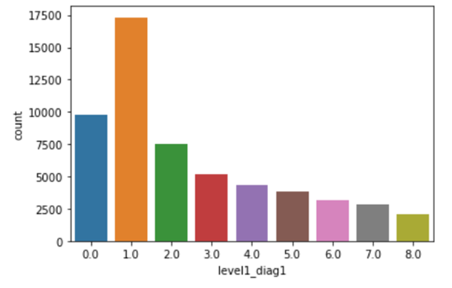
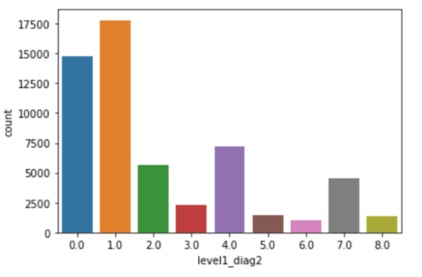
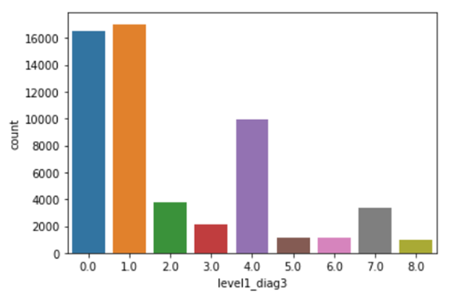
Bucketing on columns diag_1,diag_2,diag3
The dataset contained up to three diagnoses for a given patient (primary, secondary and additional).
Each of these had 700–900 unique ICD codes and it is extremely difficult to include them in the model and interpret meaningfully.
we collapsed these diagnosis codes into 9 disease categories in an almost similar fashion to that done in the original publication using this dataset.
Level1 Diag

Slide 7
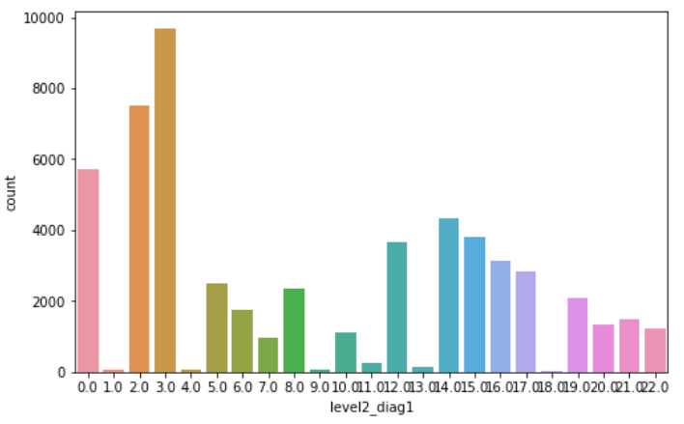
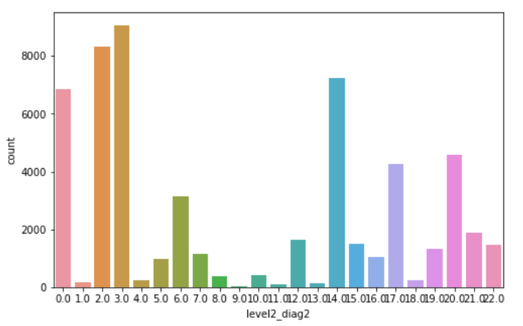
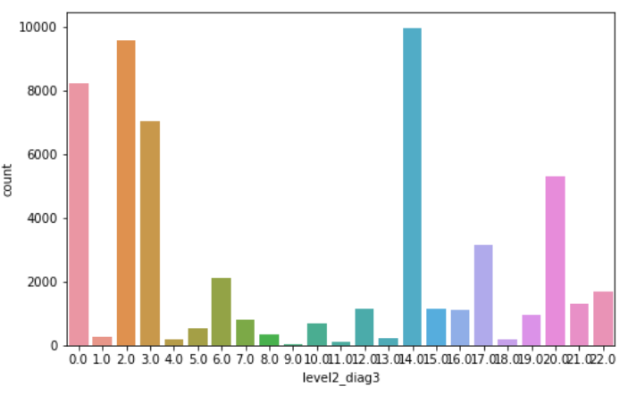
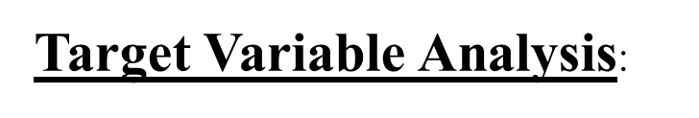
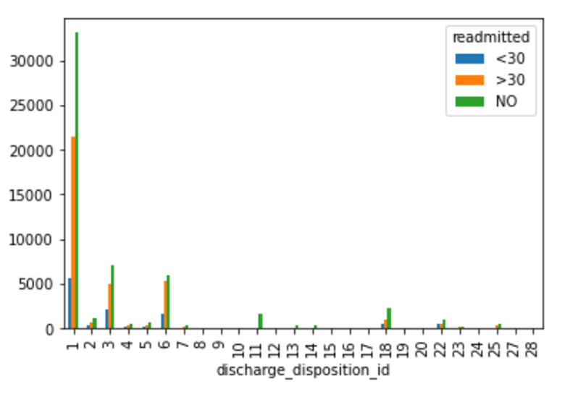
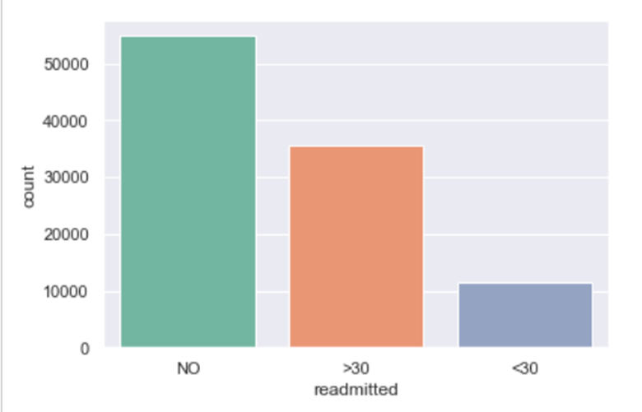
Level2 Diag
Discharge id 1 corresponds to patients discharged to home.

Slide 8
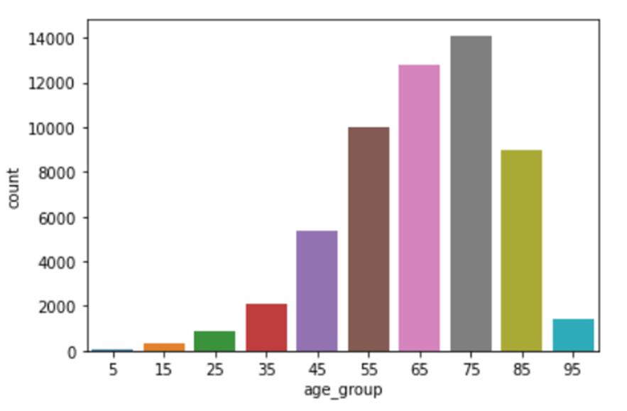
Discarding data points:
We can see that 11,13,14,19,20,21 are related to death or hospice. We will remove these samples from the predictive model since they cannot be readmitted.
Death or hospice records constitutes 2423 rows.
Discarding multiple encounters of same patients because this increases biasness.
Age Column
Age: Majority of the cases fall in the range of above 50+ years to 90 years.

Slide 9
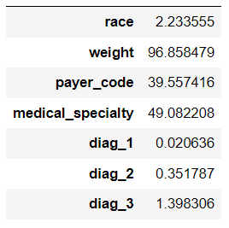
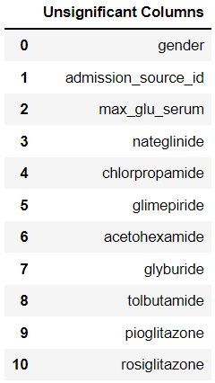
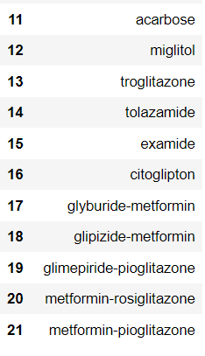
Data Processing:
Null Values Percentage
Statistical Analysis
The data in the columns weight, payer_code, medical_speciality has null value percentage is equal to or greater than 40.
Outlier Treatment:
We have used Z-score method to handle outliers in our dataset.

Slide 10
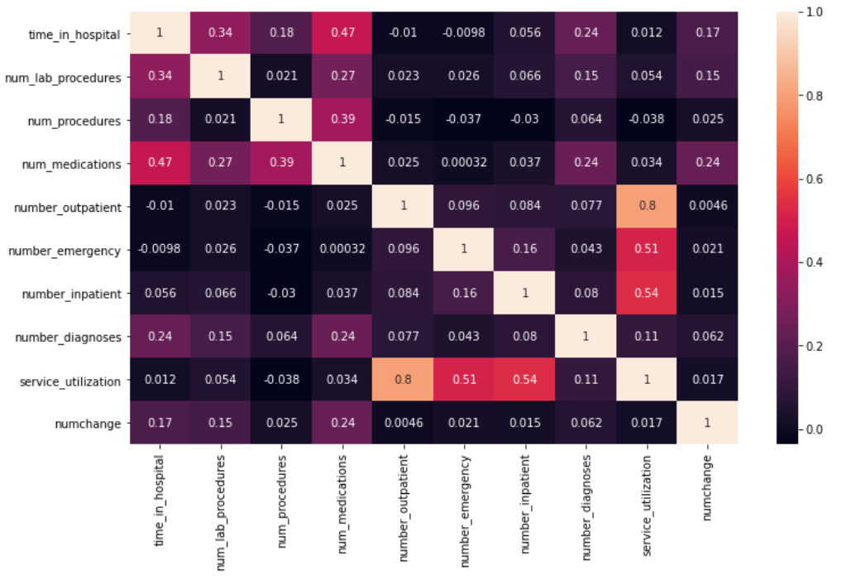
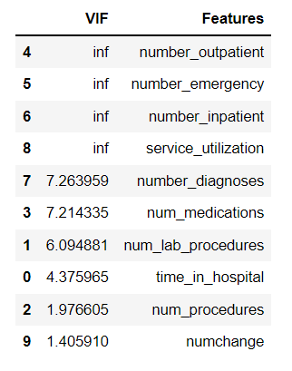
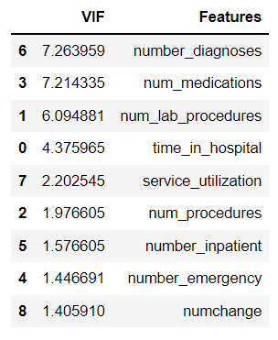
Correlation Matrix
Variation Inflation Factor
Found high multi collinearity between 4 features – number_outpatient, number_emergency, number_inpatient, service_utilization

Slide 11
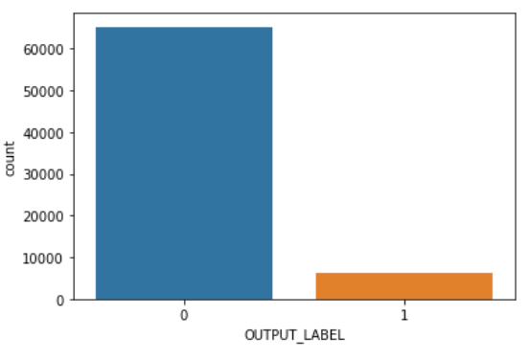
EDA Analysis Overview:
Null Values in our dataset are in the form of ‘?’.
Identified the features which are not effective in predictive in target variable.
In our dataset we have discarded patients data related to death or hospice as it is not useful in predicting readmission of patients.
We see average of 3 days patient is being treated in the hospital.
We observe minimal number of emergency cases in our dataset.
In our dataset we observe most of the patients have not been readmitted, among the patients who have been readmitted the ratio of patients readmitted >30 days is more than patients readmitted <30 days.
SMOTE technique :
Target variable is highly imbalanced .Used SMOTE technique for handling imbalanced data.

Slide 12
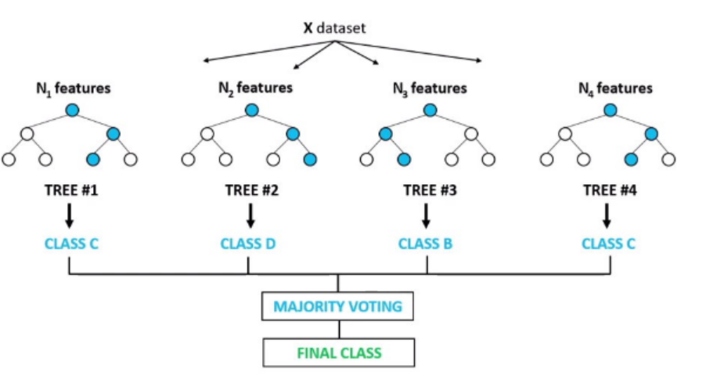
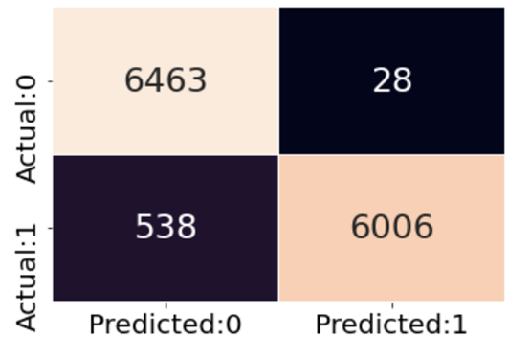
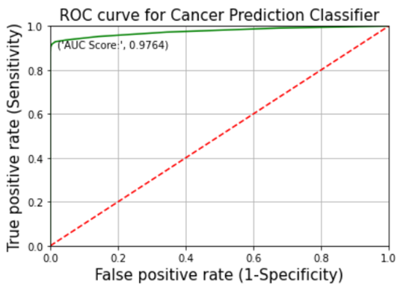
Model Building
Optimal Model - Random Forest

Slide 13
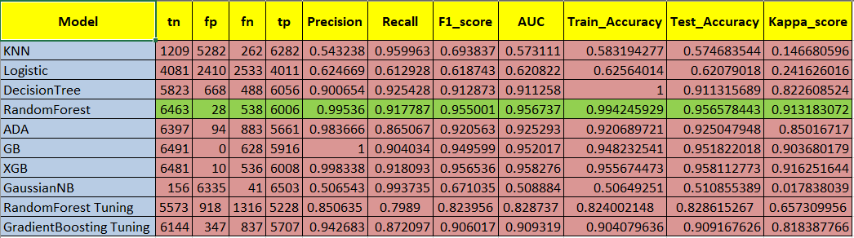
Comparison between various ML models

Slide 14
Conclusion
The factors influencing 30 days readmission predictions in diabetic patients, including number of inpatient admissions, age, diagnosis, and number of emergencies would help healthcare providers to identify patients who are at high risk of short-term readmission and reduce the probability of 30 days readmission. The RF algorithm with the highest AUC is more suitable for making 30 days readmission predictions and deserves further validation in clinical trials.

Slide 15
Thank you

